Slide 1
Classification project
Extract game features from screenshots and description

Slide 2
Motivation
Feature Engineering
Screenshots
Description
Tabular data
CNN
CNN/RNN
Genre
Theme
Publisher
...
...
Meta model
Predict Sales/Score
Style
Mood
Developer

Slide 3
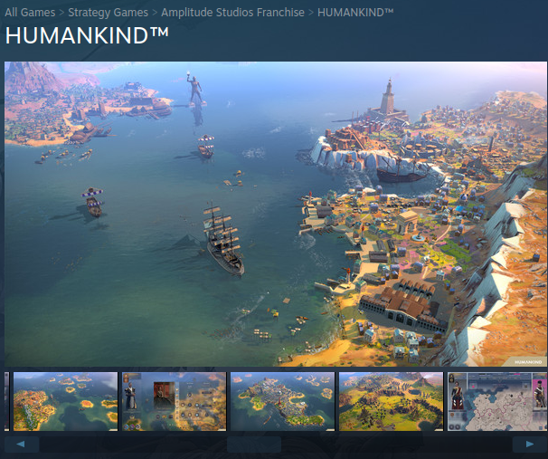
Project brief
Goal: Predict a game genre from screenshots
Dataset resource: Steam website
Model: Convolutional Neural Network
CNN
Strategy

Slide 4
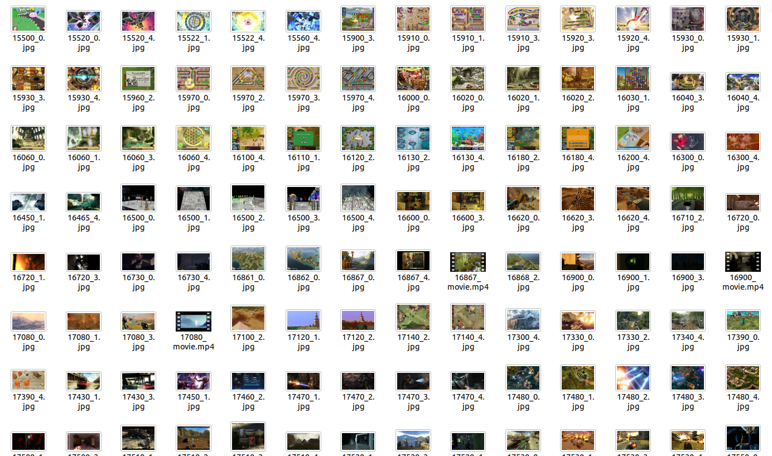
Dataset

Slide 5
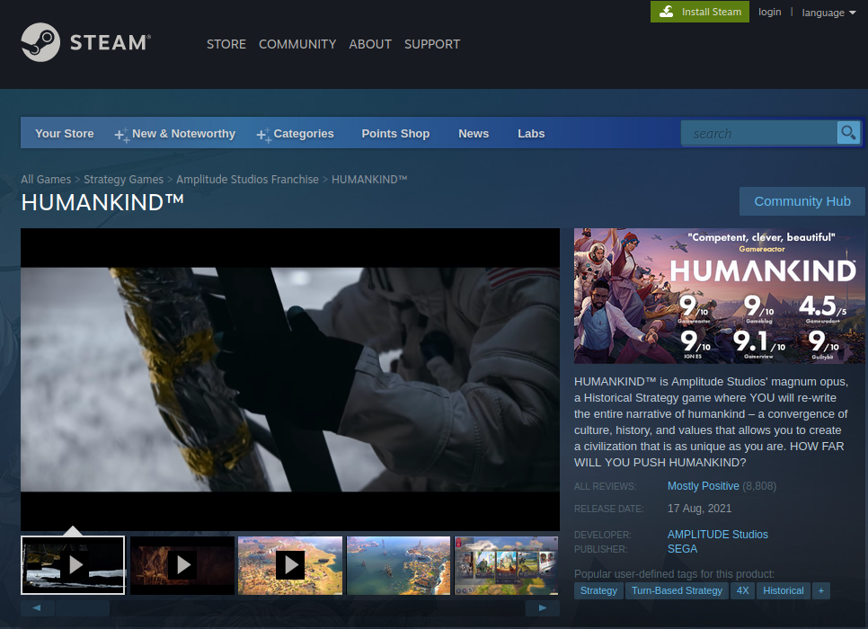
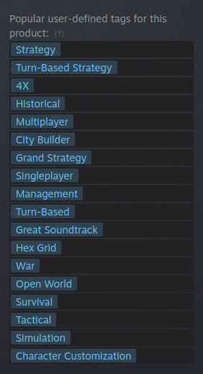
Targets
Base: popular user-defined tags

Slide 6
Data Transform
From image files to processed tensor
RGB PIL Image
import torchvision.transforms as T for filepath in filepaths.split(','):
Img =Image.open(f"{self.data_dir}/{filepath}").convert('RGB')
transform = T.Compose([T.Resize((45, 33)), T.ToTensor()]) float_img_tensor = transform(img).float()
Resize
Convert to tensor
Calculate mean/std
channels_sum, channels_squared_sum, num_batches = 0, 0, 0
for x, _ in iter(dataset):
channels_sum += torch.mean(x, dim=dim)
channels_squared_sum += torch.mean(x**2, dim=dim)
num_batches += 1
mean = channels_sum/num_batches
std = (channels_squared_sum/num_batches - mean**2)**0.5
Add Normalize
to transform

Slide 7
Model architecture
Multi-class
GAME 1
Action
CNN
Model
Casual
SOFTMAX
Strategy
Simulation
GAME N
Metric: Accuracy Criterion: Cross Entropy Loss

Slide 8
Custom Dataset
class Screenshots(torch.utils.data.Dataset):
(...)
def read_data(self, multilabel=True):
raw_data = pd.read_csv(f'{self.data_dir}/multilabel.csv', error_bad_lines=False)
(...)
Images, targets = [], []
for filepaths, label in zip(raw_data['filepaths'], raw_data['label']):
label = torch.tensor([int(label) for label in label.split(',')])
for filepath in filepaths.split(','):
float_img_tensor = transform(Image.open(f"{self.data_dir}/{filepath}").convert('RGB')).float()
images.append(float_img_tensor)
targets.append(label)
return torch.stack(images), torch.stack(targets).float()

Slide 9
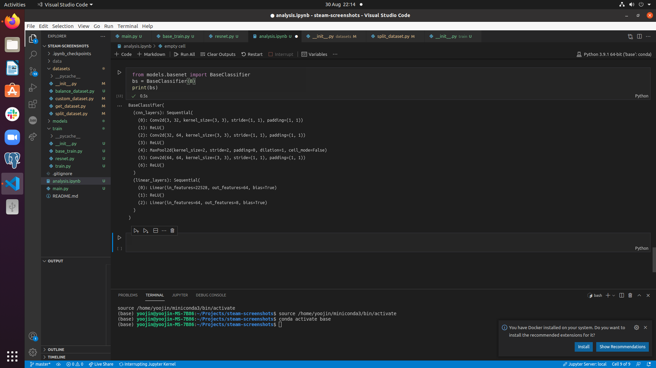
Models
Base
Resnet50
from torchvision import models
resnet = models.resnet50(pretrained=True)
num_features = resnet.fc.in_features
resnet.fc = nn.Linear(num_features, 4)
ct = 0
for child in resnet.children():
ct += 1
if ct < 6:
for param in child.parameters():
param.requires_grad = False
train_accuracy | val_accuracy
0.305 | 0.285
train_accuracy | val_accuracy
0.648 | 0.305

Slide 10
Regularization
Weight decay & data transform
data_transforms = {
'train': [
T.Resize((45, 33)),
T.RandomVerticalFlip(p=0.5),
T.RandomHorizontalFlip(p=0.5),
T.ToTensor()], …
}
Model | train_accuracy | val_accuracy
Base | 0.305 | 0.285
Resnet50 | 0.648 | 0.305
Resnet50 weight decay | 0.585 | 0.390
Resnet50 Data transformation | 0.632 | 0.393

Slide 11
Result
The best multiclass model is expected to predict a genre with 0. 373 accuracy
The performance is not great, anything to improve?
Type | Issue | Solution
Data | Data for some classes are insufficient | Collect more dataset
Modeling | One game is tagged with multiple genres (e.g. Portal2 is tagged as Puzzle but also as Action) | Use multilabel instead of multiclass

Slide 12
Model architecture
Multi-label
GAME 1
Action
Adventure
CNN
Model
Shooter
Strategy
Sigmoid
Simulation
Arcade
GAME N
Puzzle
Casual
Metric: mean Accuracy Precision @ 3 Criterion: Binary Cross Entropy Loss
RPG

Slide 13
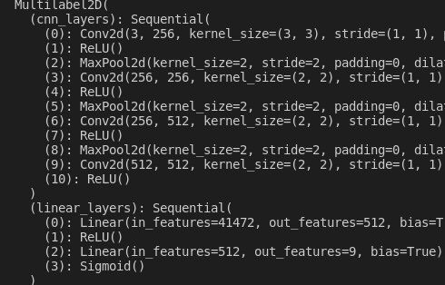
Models
Base
Resnet50
resnet = models.resnet50(pretrained=True)
num_features = resnet.fc.in_features
resnet.fc = nn.Sequential(
nn.Linear(num_features, num_output),
nn.Sigmoid()
)
ct = 0
for child in resnet.children():
ct += 1
if ct < 4:
for param in child.parameters():
param.requires_grad = False

Slide 14
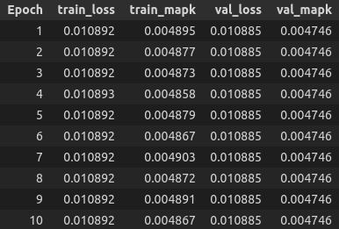
Issue encountered
Model is not learning!
Data - Batch size
Model - CNN
Criterion - BCE loss
Optimiser - Type - Learning rate

Slide 15
Base model result
Model | Params |  | Train |  | Validation
 | Optimiser | Lr | mAP@3 | best mAP@3 | mAP@3 | best mAP@3
Base | Adam | 0.01 | 0.00489 | 0.01289 | 0.00475 | 0.0127
Base | Adam | 0.001 | 0.00523 | 0.01289 | 0.00505 | 0.0127
Base | Adam | 0.0001 | 0.01282 | 0.01289 | 0.00895 | 0.0127
Base | Adam | 0.00001 | 0.00811 | 0.01289 | 0.00790 | 0.0127
Base | SGD | 1 | 0.00922 | 0.01289 | 0.00826 | 0.0127
Base | SGD | 0.1 | 0.00786 | 0.01289 | 0.00763 | 0.0127
Base | SGD | 0.05 | 0.00703 | 0.01289 | 0.00701 | 0.0127
Base | SGD | 0.01 | 0.00647 | 0.01289 | 0.00659 | 0.0127

Slide 16
Resnet50 model result
Model | Params |  | Train |  | Validation
 | Optimiser | Lr | mAP@3 | best mAP@3 | mAP@3 | best mAP@3
Base | Adam | 0.0001 | 0.01282 | 0.01289 | 0.00895 | 0.0127
Resnet50 | Adam | 0.0001 | 0.01289 | 0.01289 | 0.00982 | 0.0127
Base | SGD | 1 | 0.00922 | 0.01289 | 0.00826 | 0.0127
Resnet50 | SGD | 1 | 0.00334 | 0.01289 | 0.00337 | 0.0127

Slide 17
Result
Model | Params |  | Train |  | Validation
 | Optimiser | Lr | mAP@3 | best mAP@3 | mAP@3 | best mAP@3
Resnet50 -1 | Adam | 0.0001 | 0.01289 | 0.01289 | 0.00982 | 0.0127
Resnet50 -2 | Adam | 0.0001 | 0.01289 | 0.01289 | 0.00988 | 0.0127
The best multiclass model is expected to predict a genre with mAP@3: 0.00798 / 0.01000

Slide 18
Summary
What I achieved from the project
Collected and organised image files
Labeled the collected image files
Created custom dataset for image files
Created multiclass CNN model
Created multilabel CNN model
Used different metrics for multilabel classification
Used transfer learning and created resnet50 for my dataset
Used data transform for regularization
Understood the impact of the learning rate between optimisers

Slide 19
Summary
What I need to do in future
GAME
GAME
Organising the coding to tune the hyper parameters & compare models automatically
Implementing 3D multilabel CNN model
Predicting more features than a genre
Using description as feature for deep learning
CNN
Model

Slide 20
Thank you!

